Slide 1




Prepared by :-
Name :-Lakhmani Purv Shaileshbhai
Enroll :-23002171410028
Batch :- A1-CS&IT
Roll no:-10
This Photo by Unknown Author is licensed under CC BY-SA

Slide 2
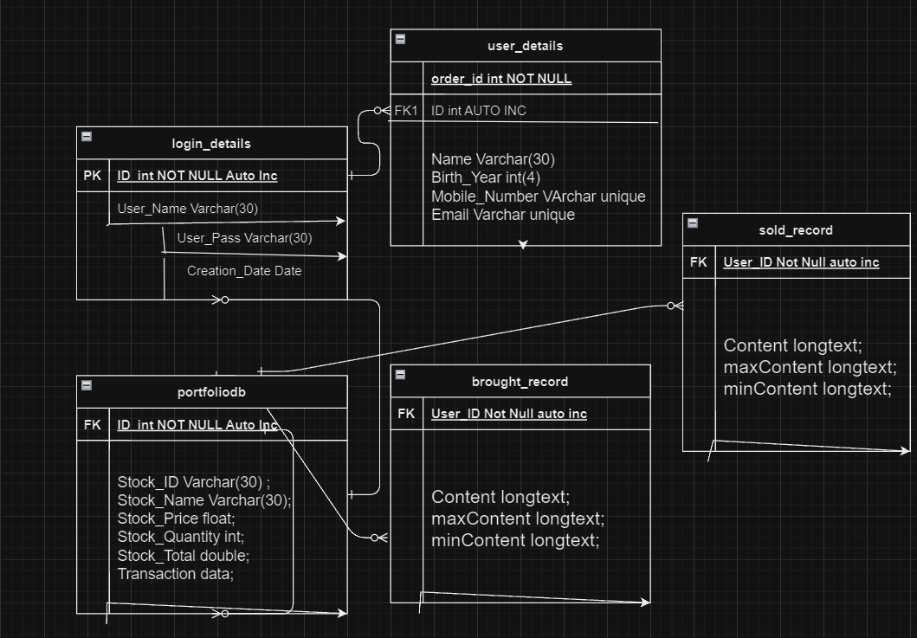
Schema

Slide 3
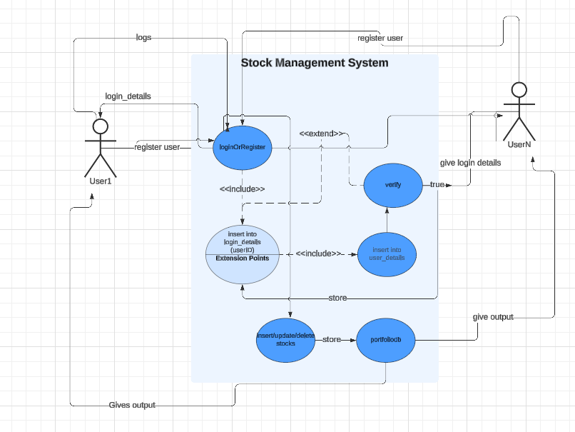
Use Case Diagram

Slide 4
Functionality
Java:
Conditional Statements.
String Manipulation.(for ex. Reverse,email format)
→ Exception Handling.
→ File Handling.
→ Loops
→ Switch cases
→ OTP Generator
DS:
→ Arrays.
→ Insertion in doubly linked list from database.
→ Display in doubly linked list.
DBMS:
→ DML (Data Manipulation Language) queries.
→ Triggers.
→ Primary key,Foreign key,Unique.

Slide 5
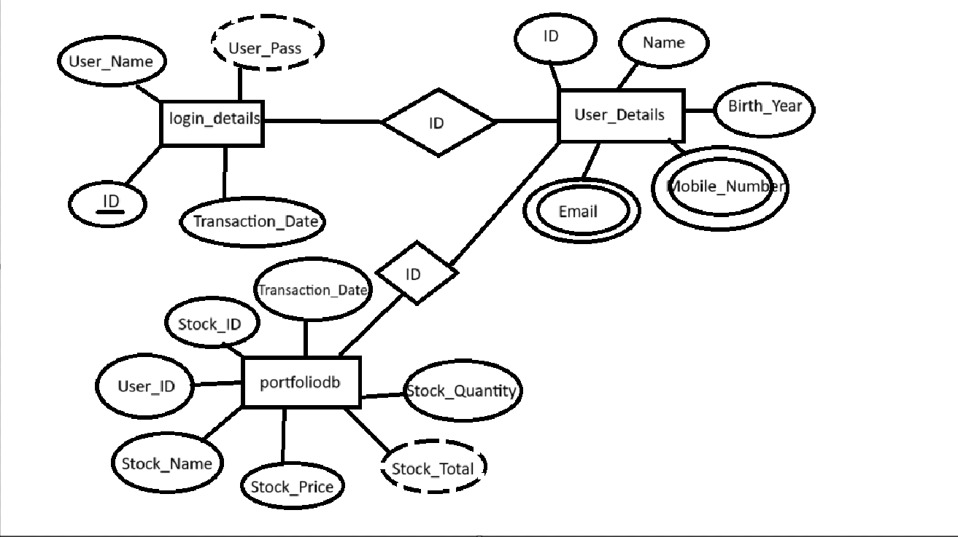
ER DIAGRAM(Entity-Relation)

